Slide 1
Objectives
In this session, you will learn to:
  Explain the differences between HTML controls and Web server controls
  Describe the different types of Web server controls
  Explain how to use HTML controls and Web server controls
  Explain how the postback model of ASP.NET 2.0 works
  Create Web-based user interfaces with HTML controls and Web server controls
  Write code that interacts with Web server controls
  Write code that interacts with the postback model of ASP.NET 2.0

Slide 2
HTML Controls and Web Server Controls
HTML Controls:
  HTML controls are used to add static HTML elements to a Web page.
  By default, HTML controls are not accessible to the server-side code in the Web page.
  To enable your server-side code to interact with HTML controls, you must specify that the control runs on the server.
Web Server Controls:
  Web Server controls are .NET Framework objects that are converted by ASP.NET to HTML elements at run time.
  On receiving a request for a Web page containing Web server controls, ASP.NET :
    Generates HTML output based on the Web server controls.
    Returns the HTML output to the browser.

Slide 3
HTML Controls and Web Server Controls (Contd.)
Difference between HTML controls and Web server controls:
  Web Server controls are more versatile than HTML controls if you wish to run server-side code associated with controls.
  Web Server controls incur more overhead when processing the page as compared to HTML controls.
  Web Server controls support a rich programming model as compared to their HTML equivalents.

Slide 4
Types of Web Server Controls
Visual Studio 2005 groups Web server controls together in the Toolbox, based on their functionality.
The various groups of controls are:
  Standard Controls
  Data Controls
  Validation Controls
  Navigation Controls
  Login Controls
  WebPart Controls
Notes:
Show all the controls using visual studio and discuss the use of few controls.

Slide 5
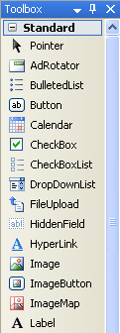
Types of Web Server Controls (Contd.)
Standard Controls:
  This group contains controls that provide common user interface elements.
  Standard controls include:
    TextBox
    ListBox
    DropDownList
    Checkbox
    RadioButton
    Button
    Image
    Table
    Calendar
Standard Controls
Notes:
Show all the controls using visual studio and discuss the use of few controls.

Slide 6
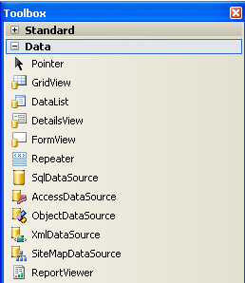
Types of Web Server Controls (Contd.)
Data Controls:
  This group contains controls used to manipulate data stored in databases, XML files, and other .NET Framework objects.
  Data controls include:
    Grid View
    SqlDataSource
Data Controls
Notes:
Show all the controls using visual studio and discuss the use of few controls.

Slide 7
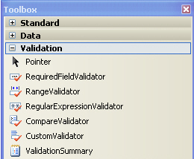
Types of Web Server Controls (Contd.)
Validation Controls:
  This group contains controls that are used to validate user input.
  Simple validation is done on the client side by generating JavaScript code. This reduces the load on the Web server and improves responsiveness.
  Complex validation is done on the Web server.
  Validation controls include:
    RequiredFieldValidator
    CompareValidator
Validation Controls
Notes:
Show all the controls using visual studio and discuss the use of few controls.

Slide 8
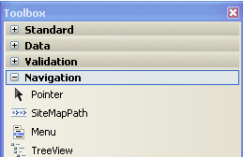
Types of Web Server Controls (Contd.)
Navigation Controls:
  The controls in this group are used to enable the user to move through the Web site.
  Navigation controls include:
    Menu
    TreeView
    SiteMapPath
Navigation Controls
Notes:
Show all the controls using visual studio and discuss the use of few controls.

Slide 9
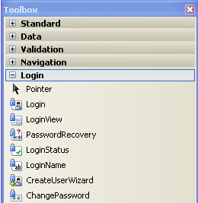
Types of Web Server Controls (Contd.)
Login Controls:
  The controls in this group are used to create login and sign-up pages for your Web sites.
  Login controls include:
    Login
    ChangePassword
    PasswordRecovery
Login Controls
Notes:
Show all the controls using visual studio and discuss the use of few controls.

Slide 10
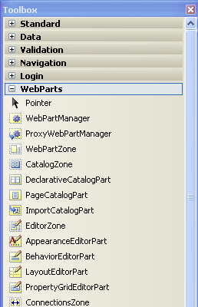
Types of Web Server Controls (Contd.)
WebPart Controls:
  The controls in this group can be used to build the framework for dynamic Web pages.
  These controls are typically used in portal-type Web applications.
  WebPart controls include:
    WebPartManager
    WebPartZone
Web Part Controls
Notes:
Show all the controls using visual studio and discuss the use of few controls.
Discuss HTML Server conrols

Slide 11
Working with Web Server Controls
Methods for adding Web server controls to Web forms:
  Drag and drop the control from the Toolbox onto the Design view of the Web page.
  Drag and drop the control from the Toolbox into the Source view of the Web page.
  Type the markup text for the control directly into the Source view of the Web page.
Notes:
Web Server controls are automatically configured with the runat="server" attribute, so there is no need to convert them as there is for HTML server controls.
Edit the ID attribute that Visual Studio automatically assigns.

Slide 12
Working with Web Server Controls (Contd.)
Methods for Setting Web Server Control Properties at Design Time:
  Select the control in the Design view and set the property values in the Properties window.
  Select the markup text for the control in the Source view and set the property values in the Properties window.
  Edit the markup text for the control directly in the Source view of the Web page.
Notes:
Show the demo by performing each step to set Web server control properties
Explain by example how to manipulate Web server control (refer SG)

Slide 13
Working with Web Server Controls (Contd.)
You can manipulate Web server controls at run time by:
  Setting a writable property
  Invoking a method
  Reading a readable property
    //Set a writable property
    Textbox1.Text = “Hello World!”;
    //Invoke a method
    TextBox1.Focus();
    //Reading a readable property
    string sName = TextBox1.Text
Notes:
Show the demo by performing each step to set Web server control properties
Explain by example how to manipulate Web server control (refer SG)

Slide 14
The ASP.NET 2.0 Page Postback Model
Postback model provides a mechanism for:
  Sending control properties on Web pages from the Web browser to the Web server.
  Restoring the values when a response is sent back from the Web server to the Web browser.
This model enables Web server controls to retain their values over multiple requests to the server.
It enables you to develop Web pages as if they are part of a stateful application.
Notes:
FAQ Explain the HTTP is state less protocol it does not store any reference of previous request even with the same user. Server has to maintain such information pragmatically.
Explain how round trip processing maintain this state.

Slide 15
The ASP.NET 2.0 Page Postback Model (Contd.)
AutoPostBack Property:
  Some Web server controls support the AutoPostBack property.
  This property controls whether user interaction with the control should invoke a round-trip request to the server.
EnableViewState Property:
  This property determines whether the control should retain its state for the duration of the postback.
  This property should be set to true for those controls whose properties are set in server-side code.
Notes:
Explain with example of ListBox and DropDownList control given SG in Auto Postback
Discuss when we set EnableViewState Property to true
Explain the difference between postback on self page and postback on crosspage

Slide 16
Cross-Page Posting in an ASP.NET Web Page
By default, buttons and other controls that cause a postback on a Web page submit the page back to itself.
Controls can be configured to post to a different target page.
To enable cross-page posting, you need to set the PostBackURL property of a control to the URL of the target page.
To retrieve control values on the submitting page from the target page, you can use the Page.PreviousPage object.
To retrieve the public properties on the submitting page from the target page, you need to include the PreviousPageType directive in the target page as:
  <%@ PreviousPageType VirtualPath= “~/SourcePage.aspx” %>
Notes:
Explain what is server transfer invocation what is Original Request invocation
Show the use of these properties by using the example given in SG.

Slide 17
Determine How an ASP.NET Web Page Was Invoked
A Web page can be invoked in a variety of ways:
  By an original request
  By a postback
  By a cross-page post from another page
  By transfer from another page by using the Server.Transfer method
To determine how a page was invoked, you can examine the following properties of the Page object:
  Page.IsPostBack: This property is true when page is invoked by a postback page and false otherwise.
  Page.PreviousPage: This property contains a reference to the source page when the page is invoked by either a cross page posting or a server transfer. In all other cases, it contains Null.
  Page.PreviousPage.IsCrossPagePostBack: This property is true when the page is invoked by a cross page posting.
Notes:
Explain what is server transfer invocation what is Original Request invocation
Show the use of these properties by using the example given in SG.

Slide 18
The Button.OnClientClick Property
Use the Button.OnClientClick property to specify
client-side script to be run when the Button object is clicked.
The code that you add to this property is added to the onclick attribute of the control.
Notes:
Explain what is server transfer invocation what is Original Request invocation
Show the use of these properties by using the example given in SG.

Slide 19
Demo: Adding and Configuring Server Controls
Problem Statement:
  You are a developer in the Adventure Works organization, a fictitious bicycle manufacturer. You have been asked to assist in the development of the Business-to-Consumer (B2C) Web application and a related Business-to-Employee (B2E) extranet portal.
  Decisions on the design of the application have already been taken. You have been asked to carry out a number of specific tasks to implement various elements of this design.

Slide 20
Demo: Adding and Configuring Server Controls (Contd.)
  As part of the first phase of the B2C development, you have been asked to complete the prototypes for the following pages:
    Survey.aspx. You will design a rich graphical user interface for this page that enables users to submit responses to an online survey. You will also add a SiteMapPath control to this page to aid user navigation.
    SurveyReceipt.aspx. You will design this page to receive the information provided by the user in the Survey.aspx page.
    FeedbackForm.aspx. You will design this page to receive the information provided by the user in the existing Feedback.aspx page.
    Default.aspx. You will add a Menu control to this page to aid user navigation.

Slide 21
Demo: Adding and Configuring Server Controls (Contd.)
  You will also add and review a Web.sitemap file that will be used to add navigation features to the Web application.
  Additionally, you will add and review an advertising schedule file that will be used to add dynamic image display features to the Web application.

Slide 22
Demo: Adding and Configuring Server Controls (Contd.)
Solution:
  To solve this problem, you need to perform the following tasks:
    Build the Graphical User Interfaces with HTML Controls
      Review the proposed design of the Survey.aspx page.
      Open the Adventure Works Web site.
      Define the Survey.aspx page layout by using HTML controls in Design view.
      Define the Survey.aspx page layout by modifying HTML markup in Source view.
      Add HTML Input controls to the Web page.

Slide 23
Demo: Adding and Configuring Server Controls (Contd.)
    Build Graphical User Interfaces with Web Server Controls
      Review the proposed design of the Survey.aspx page.
      Refine the Survey.aspx page layout by using an ASP.NET Table Web server control in Design view.
      Modify the properties of the Table Web server control.
      Add rows to the Table Web Server control by using Source view.
      Add a nested Table Web server control in Source view.
      Add Web server controls to the Table control.
      Add site navigation functionality by using Web server controls.
      Incorporate advertising functionality with Web server controls.

Slide 24
Demo: Adding and Configuring Server Controls (Contd.)
    Program Web Server Controls and Work with Postbacks
      Manage the Click event for the ImageMap object.
      Create the OnClientClick property and the server-side Click event for the Submit button.
      Determine if an ASP.NET Web page was invoked as part of the postback process.
      Create a page that can receive and process information submitted as part of a cross-page postback.
      Test the Web application.

Slide 25
Summary
In this session, you learned that:
  HTML controls are representations of HTML markup which are not accessible to the server side code.
  Web server controls are .NET Framework objects that are converted by ASP.NET to HTML elements at run time.
  Visual Studio 2005 provides many groups of Web server controls based on their functionality, such as Standard Controls and Data Controls.
  You can add Web server controls to Web forms from the Toolbox or by typing markup text.
  You can set Web server control properties at design time as well at run time.
  The ASP.NET postback model is designed to provide stateful rendering of dynamic content on a Web page.

Slide 26
Summary (Contd.)
  The Page object exposes the IsPostBack property that you can use to determine how a page was invoked.
  You can configure the controls to post to a different target page referred to as cross-page posting.
  When a page is invoked by another page, you can retrieve control values and public properties of the invoking page from the invoked page.

